Slide 1







Slide 2
Paint The Path to Homeownership:
DPA 101
Session Speakers
Deidre Smith, Vice President of Single Family
Peyton Mann, Marketing Education & Outreach Officer

Slide 3

Features
30-year fixed rate first mortgage (Rates subject to change)
FHA insured, VA, Rural Development, & Fannie Mae/Freddie Mac Loans
No liquid asset limit
$7,000 with 0% interest
Principal due upon property sale, refinance, non-owner occupied, or loan maturity
Can be used towards down payment, closing costs, or pre-paids
Purchase price cannot exceed $398,310

Slide 4
How To Qualify
Property must be owner-occupied & principal residence
Household annual income cannot exceed $132,770
Must be a legal resident of the US
Credit score is based on servicer guidelines
No first-time homebuyer requirements
Homebuyer education required

Slide 5
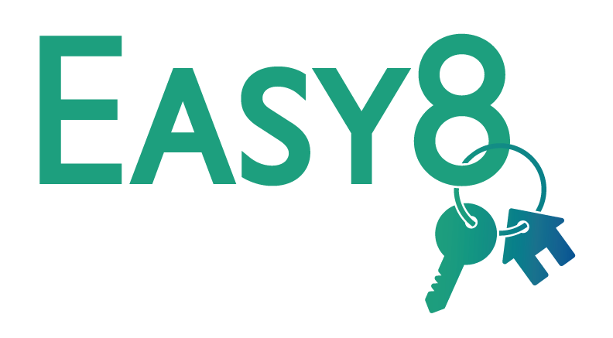
Features
30-year fixed rate first mortgage (Rates subject to change)
FHA insured, VA, Rural Development, & Fannie Mae/Freddie Mac Loans
No liquid asset limit
$8,000 with 0% interest
Principal due upon property sale, refinance, non-owner occupied, or loan maturity
Can be used towards down payment, closing costs, or pre-paids
Purchase price cannot exceed $398,310

Slide 6
How To Qualify
First-time homebuyers, or persons who have not owned a principal interest in a residence in the past 3 years.
Certain areas of the state, called “Target Areas” and Veterans are exempt from the “first-time homebuyer” rule
Households who are within the income guidelines for the county in which they purchase a home
Must be a legal resident of the US
Credit score is based on servicer guidelines
No first-time homebuyer requirements
Homebuyer education required

Slide 7

Features
30-year fixed rate first mortgage (Rates subject to change)
FHA insured, VA, Rural Development, & Fannie Mae/Freddie Mac Loans
No liquid asset limit
$10,000 down payment as a 2nd mortgage
2nd mortgage has a 2% interest rate
15-year loan
Can be used towards down payment, closing costs, or pre-paids

Slide 8
How To Qualify
First-time homebuyers, or persons who have not owned a principal interest in a residence in the past 3 years.
Certain areas of the state, called “Target Areas” and Veterans are exempt from the “first-time homebuyer” rule
Households who are within the income guidelines for the county in which they purchase a home
Must be a legal resident of the US
Credit score is based on servicer guidelines
No first-time homebuyer requirements
Homebuyer education required

Slide 9
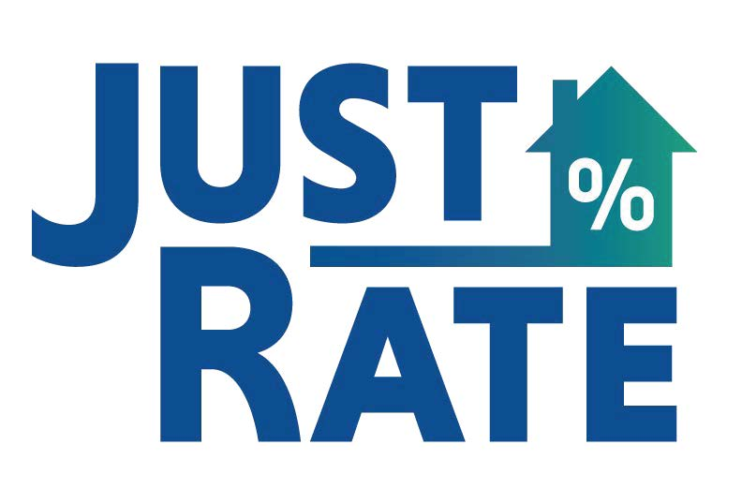
Features
30-year fixed rate first mortgage (Rates subject to change)
FHA insured, VA, Rural Development, & Fannie Mae/Freddie Mac Loans
No liquid asset limit
Receive a lower rate than any other MRB Programs

Slide 10
How To Qualify
First-time homebuyers, or persons who have not owned a principal interest in a residence in the past 3 years.
Certain areas of the state, called “Target Areas” and Veterans are exempt from the “first-time homebuyer” rule
Households who are within the income guidelines for the county in which they purchase a home
Must be a legal resident of the US
Credit score is based on servicer guidelines
No first-time homebuyer requirements
Homebuyer education required

Slide 11

Features
MS Dept. of Education assistance will cover the amount of borrower funds needed to close on a home up to $6,000.
Grant assistance is forgiven if the approved licensed teacher satisfies a required executed Loan Agreement.
The Loan Agreement requires the applicant to be employed for a period of no less than three (3) years in a school district where a critical shortage of teachers exists.
Homebuyer(s) must provide a minimum down payment from one’s own funds of 1% of the sales price and one month’s reserves
Reserves requirement may be gifted from a relative, but not the 1% down payment contribution.

Slide 12
How To Qualify
Applicants who agree to render service as a teacher in the district for three years starting with the beginning of the school year
Applicants meeting the credit eligibility requirements of FHA, VA, RD Guaranteed, Fannie Mae or Freddie
25 or 30-year fixed loan rate, unless using with another MHC Program
No income limits unless using with another MHC loan product (see other program guidelines)
May be combined with MHC’s Smart7, Easy8, Trusty10, or JustRate program

